Slide 1
Reflection

Slide 2
Java Reflection is a process of examining or modifying the run time behavior of a class at run time.
Reflection gives us information about the class to which an object belongs and also the methods of that class which can be executed by using the object.
The java.lang.Class class provides many methods that can be used to get metadata, examine and change the run time behavior of a class.
The java.lang and java.lang.reflect packages provide classes for java reflection.

Slide 3
1) public String getName() | returns the class name
2) public static Class forName(String className)throws ClassNotFoundException | loads the class and returns the reference of Class class.
3) public Object newInstance()throws InstantiationException,IllegalAccessException | creates new instance.
4) public boolean isInterface() | checks if it is interface.
5) public boolean isArray() | checks if it is array.
6) public boolean isPrimitive() | checks if it is primitive.
7) public Class getSuperclass() | returns the superclass class reference.
8) public Field[] getDeclaredFields()throws SecurityException | returns the total number of fields of this class.
9) public Method[] getDeclaredMethods()throws SecurityException | returns the total number of methods of this class.
10) public Constructor[] getDeclaredConstructors()throws SecurityException | returns the total number of constructors of this class.

Slide 4
11) public Method getDeclaredMethod(String name,Class[] parameterTypes)throws NoSuchMethodException,SecurityException | returns the method class instance.

Slide 5
How to get the object of Class class?
There are 3 ways to get the instance of Class class. They are as follows:
forName() method of Class class
getClass() method of Object class
the .class syntax

Slide 6
1) forName() method of Class class
is used to load the class dynamically.
returns the instance of Class class.
It should be used if you know the fully qualified name of class.This cannot be used for primitive types.
EX.
Class c=Class.forName("Simple");
System.out.println(c.getName());

Slide 7
2) getClass() method of Object class
It returns the instance of Class class. It should be used if you know the type. Moreover, it can be used with primitives.
EX.
Object obj=new Object();
Class c=obj.getClass();
System.out.println(c.getName());

Slide 8
3) The .class syntax
If a type is available, but there is no instance, then it is possible to obtain a Class by appending ".class" to the name of the type. It can be used for primitive data types also.
Ex.
Class c = boolean.class;
System.out.println(c.getName());

Slide 9
JVM (Java Virtual Machine) Architecture
JVM (Java Virtual Machine) is an abstract machine. It is a specification that provides runtime environment in which java bytecode can be executed.
JVMs are available for many hardware and software platforms (i.e. JVM is platform dependent).

Slide 10
What is JVM
A specification where working of Java Virtual Machine is specified. But implementation provider is independent to choose the algorithm. Its implementation has been provided by Oracle and other companies.
An implementation Its implementation is known as JRE (Java Runtime Environment).
Runtime Instance Whenever you write java command on the command prompt to run the java class, an instance of JVM is created.

Slide 11
What it does
Loads code
Verifies code
Executes code
Provides runtime environment
JVM provides definitions for the:
Memory area
Class file format
Register set
Garbage-collected heap
Fatal error reporting etc.

Slide 12
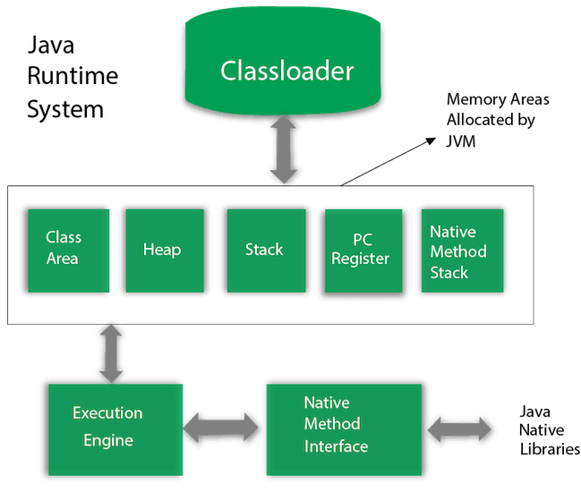
JVM Architecture

